Slide 1
Input
Layer
Hidden
Layer
Distance
Layer
Output
Layer
x_{1,1}
h_{1,1}
x_{1,N1}
h_{1,N2}
d₁
p
x_{2,1}
h_{2,1}
d_{N2}
x_{2,N1}
h_{2,N2}

Slide 2
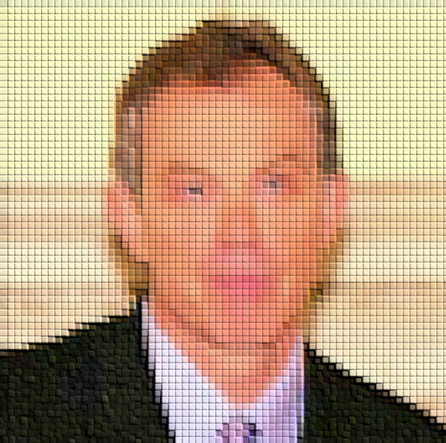
Input images
1 @ 100x100
Feature maps
64 @ 96x96
Feature maps
64 @ 48x48
Feature maps
128 @ 42x42
Feature maps
128 @ 21x21
Feature maps
128 @ 18x18
Feature maps
128 @ 9x9
Feature maps
256 @ 6x6
Feature maps
4096
Output
1x1
Convolution +ReLU,
64 @ 10x10
Max-pooling
64 @ 2x2
Convolution +ReLU,
128 @ 7x7
Max-pooling
64 @ 2x2
Convolution +ReLU,
128 @ 4x4
Max-pooling
64 @ 2x2
Convolution +ReLU,
256 @ 4x4
Fully connected +
Sigmoid,
L1 Siamese Dist
Fully connected

